Slide 1




Streamlit Fundamentals
Presented by:
Dr Grace U. Nneji
Dr Happy N. Monday

Slide 2


Learning Outcomes
Build UI components like sliders, text inputs, and buttons using Streamlit
Understand the reactive rerun model used by Streamlit
Use session state to preserve values between interactions
Design dynamic layouts with columns, sidebar, and expander widgets
Create interactive dashboards using real-world energy data

Slide 3
Introduction to Streamlit
An open-source library that allow users to create interactive web apps for data science and ML with minimal code.
Widely used in ML to create:
Data dashboards
Interactive model exploration tools
Real-time analytics interfaces

Slide 4
Installation and First Run
pip install streamlit
Run an app (eg, app.py) with:
streamlit run app.py

Slide 5



Core Widgets in Streamlit
Widgets are UI elements such as sliders, text inputs, and buttons. They help gather user input in an interactive interface.
st.slider () - Range Input
A slider allows users to select a value or range
Use Case: Set energy thresholds or prediction intervals.

Slide 6


st.text_input() - Text Box
This capture user text
Use Case: Ask users for a building name, user ID, or annotation input.
st.button() - Event Trigger
This trigger specific actions
Use Case: Trigger predictions or reset views.

Slide 7
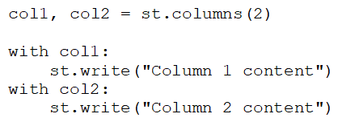
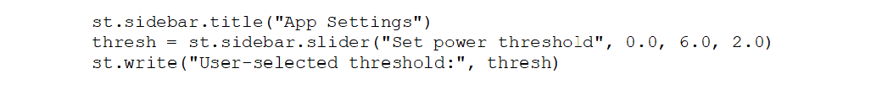
Layout and Structure
Columns -Side-by-side Arrangement
For horizontal layout
Use Case: Visualize predictions beside input controls.
Sidebar - Filters and Settings
Place settings and filters in a side menu
Use Case: Parameter control without cluttering main UI.
Expander

Slide 8
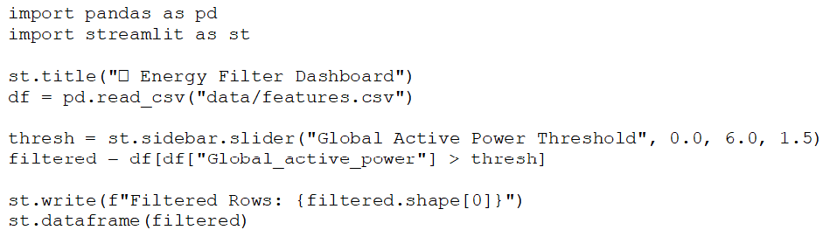
Interactive Threshold Filter
Expected Outcome:
Sidebar slider filters data
Interactive output updates in real-time
Styling & Advanced Widgets
Use st.markdown() for HTML
st.markdown() adds custom styling using raw HTML

Slide 9
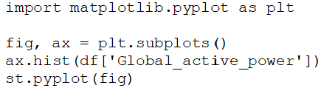
Plotly & Matplotlib Support
Media Integration

Slide 10

Thank You for Your Attention!
Let's collaborate and build amazing data apps together using Streamlit!

